Slide 1
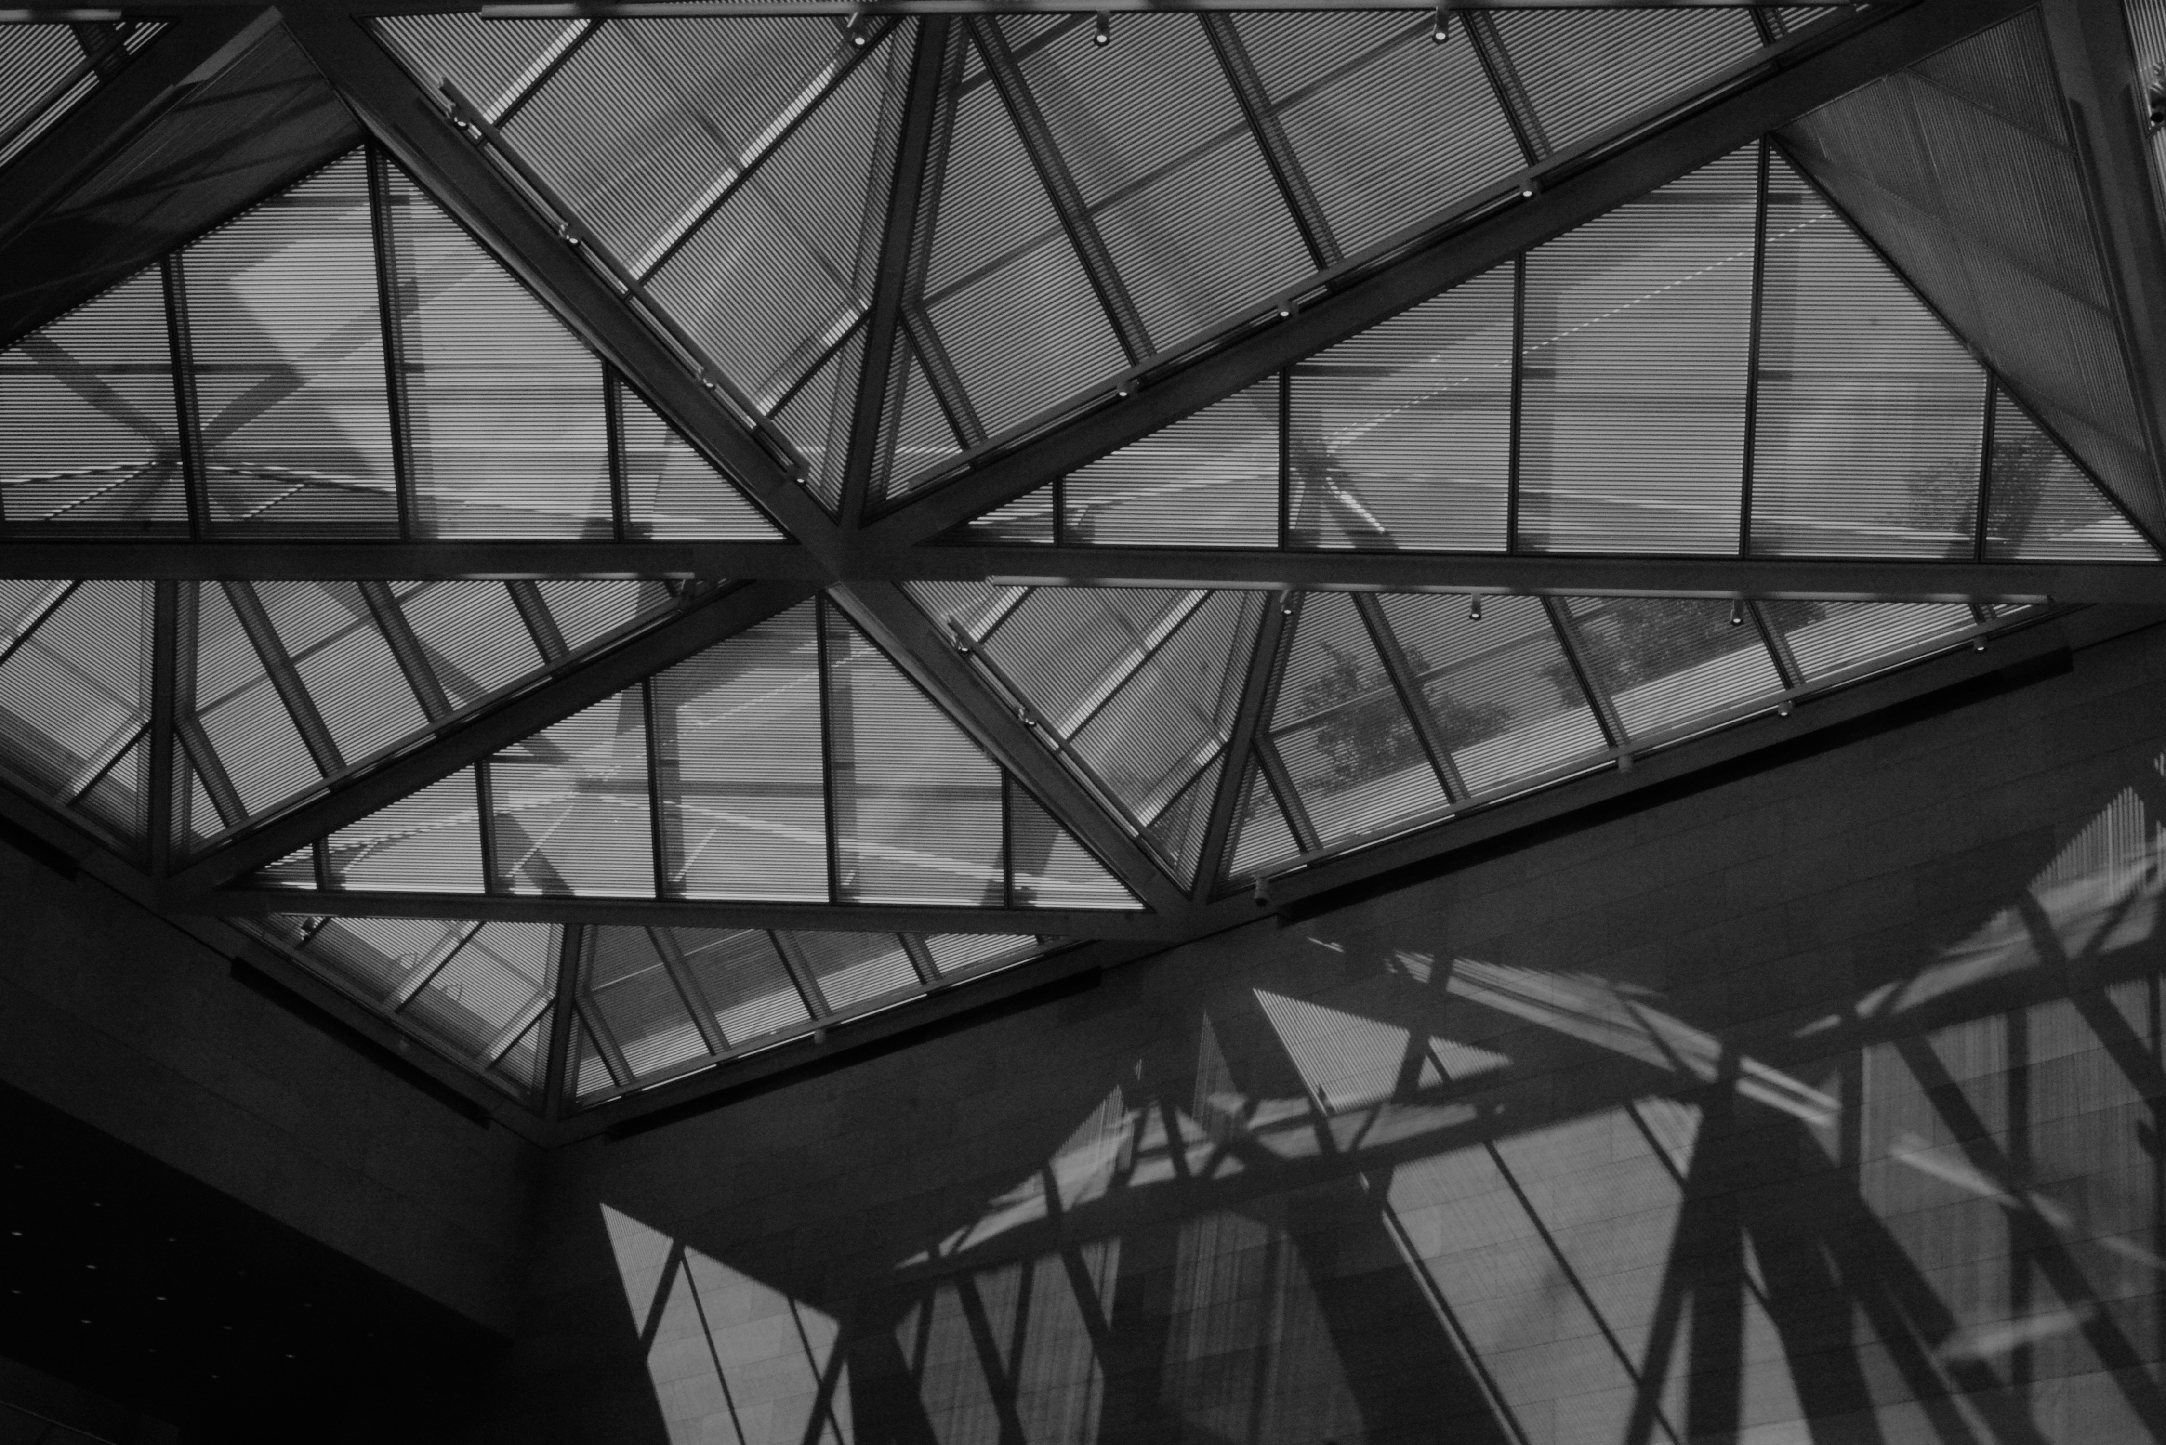
The Amazing TMazing
A PO-MDP OpenAI Gym Implementation
simulating T-maze Based DNMTS Task

Slide 4
Chapter 1
How does RL work ? Brief on MDP and PO-MDP

Slide 5
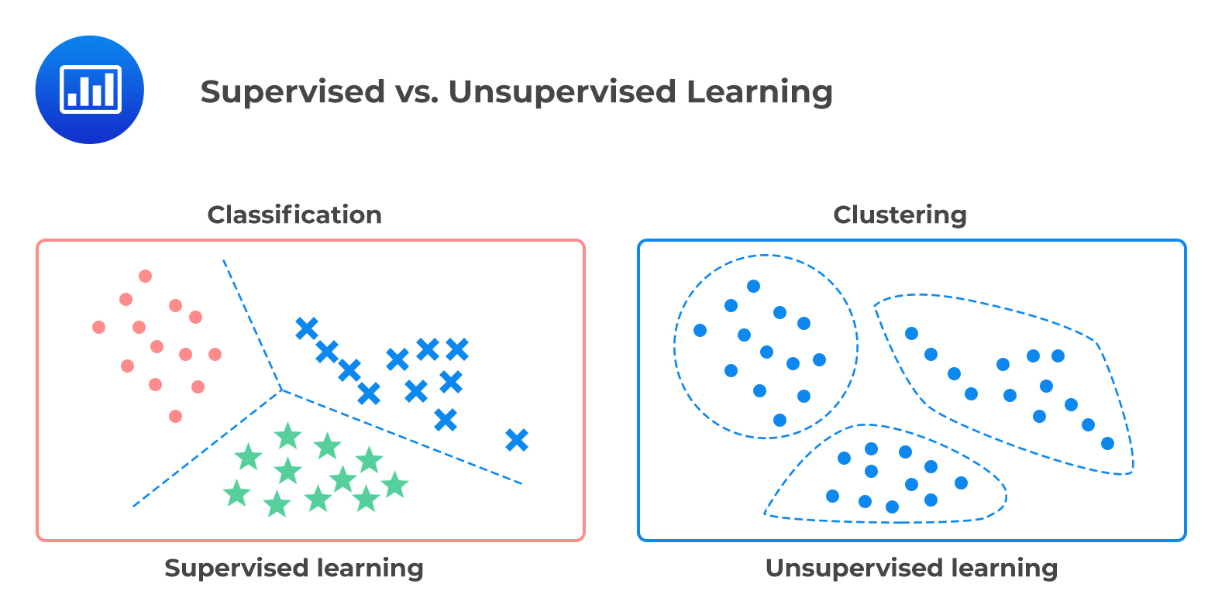
Classic Machine Learning
How does RL work ? Brief on MDP and PO-MDP

Slide 6
Classic Machine Learning
Supervised Learning: Modeling Feature-Label Mapping
Unsupervised Learning: Summaring Unstructured Data

Slide 8
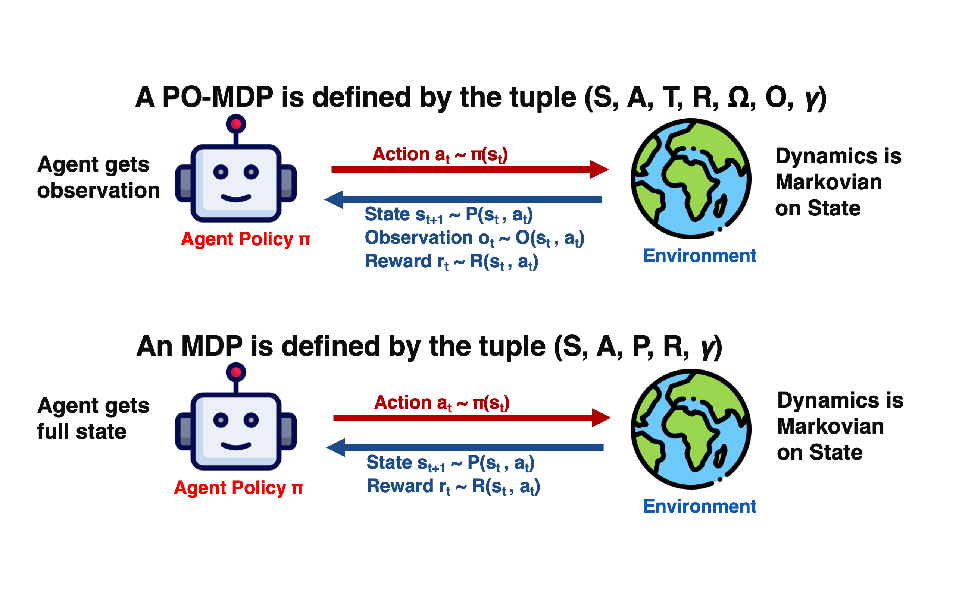

Slide 9
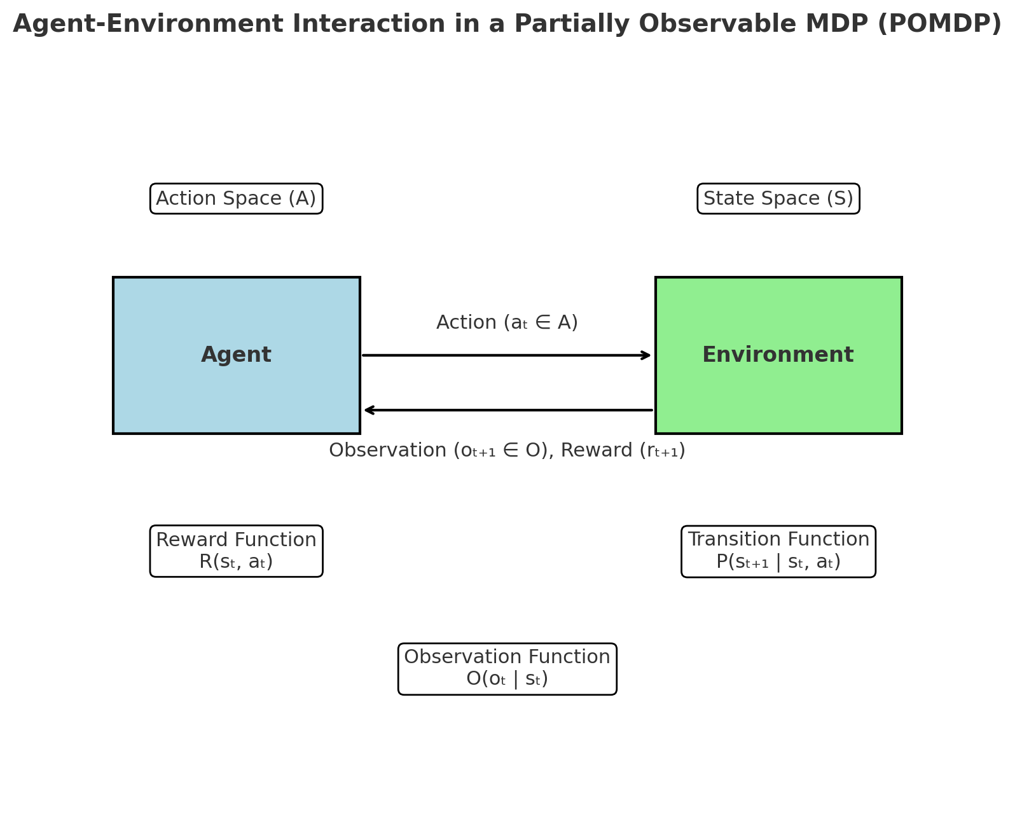
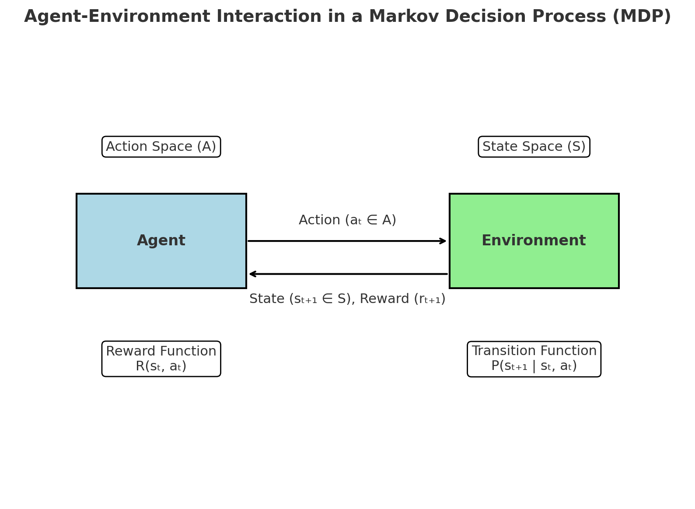

Slide 10
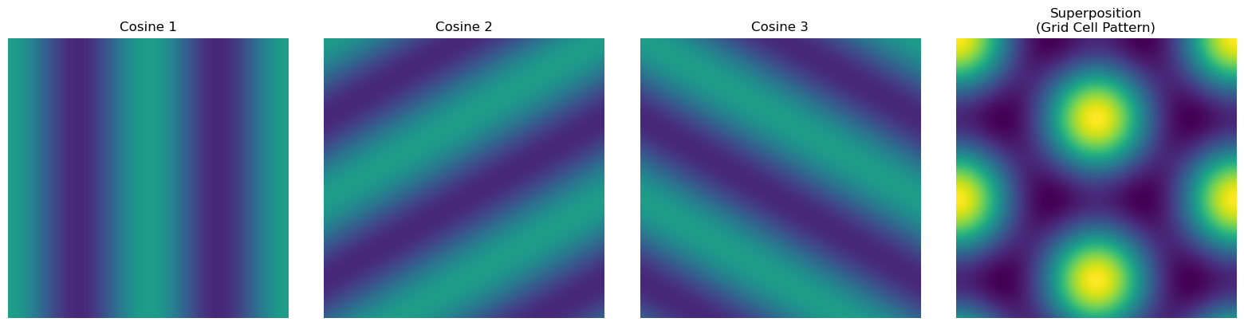
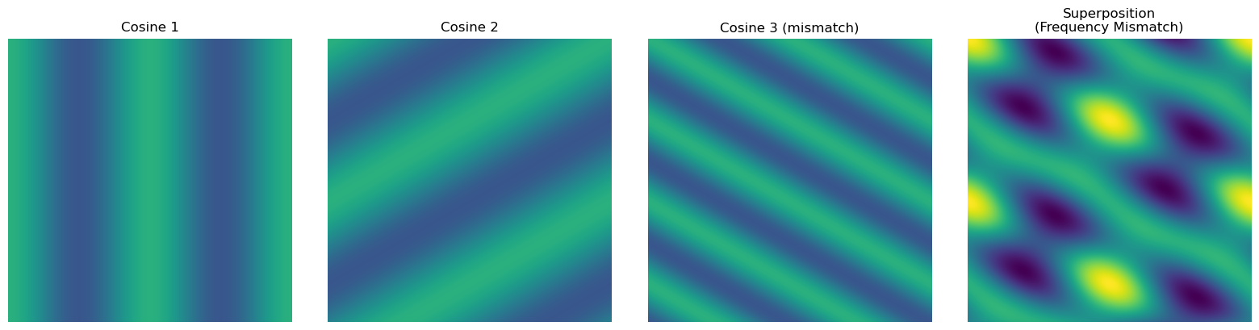

Slide 11
